Slide 1
Forecasting image processing sun position correction

Slide 2
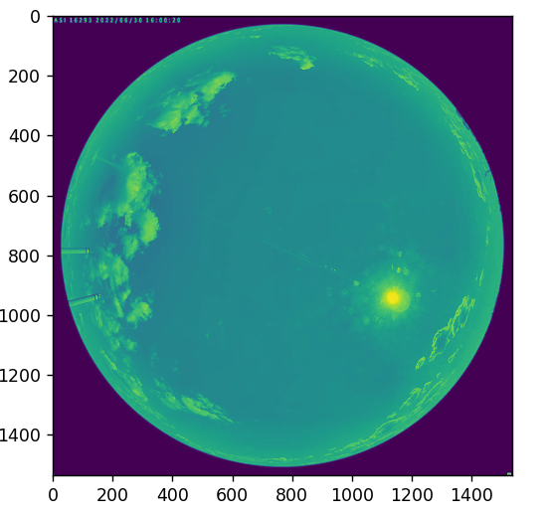
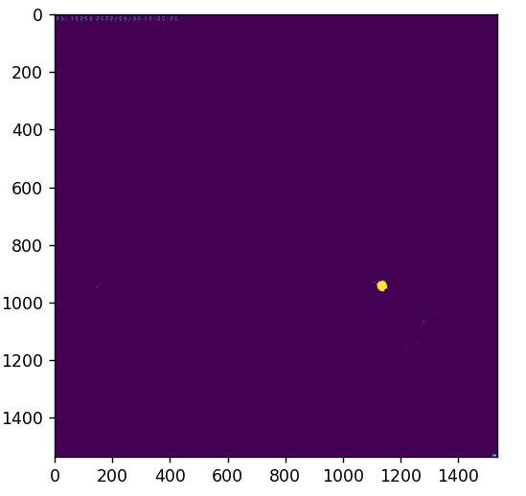
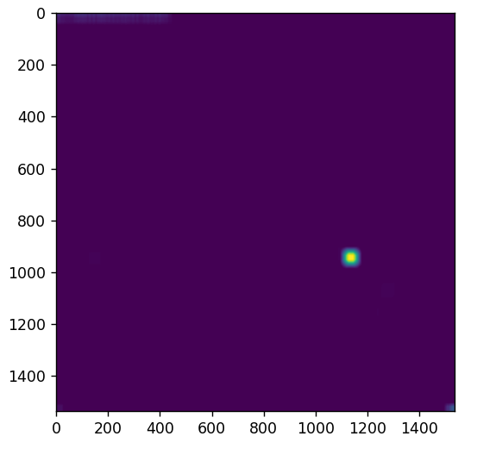
Finding the sun

Slide 3
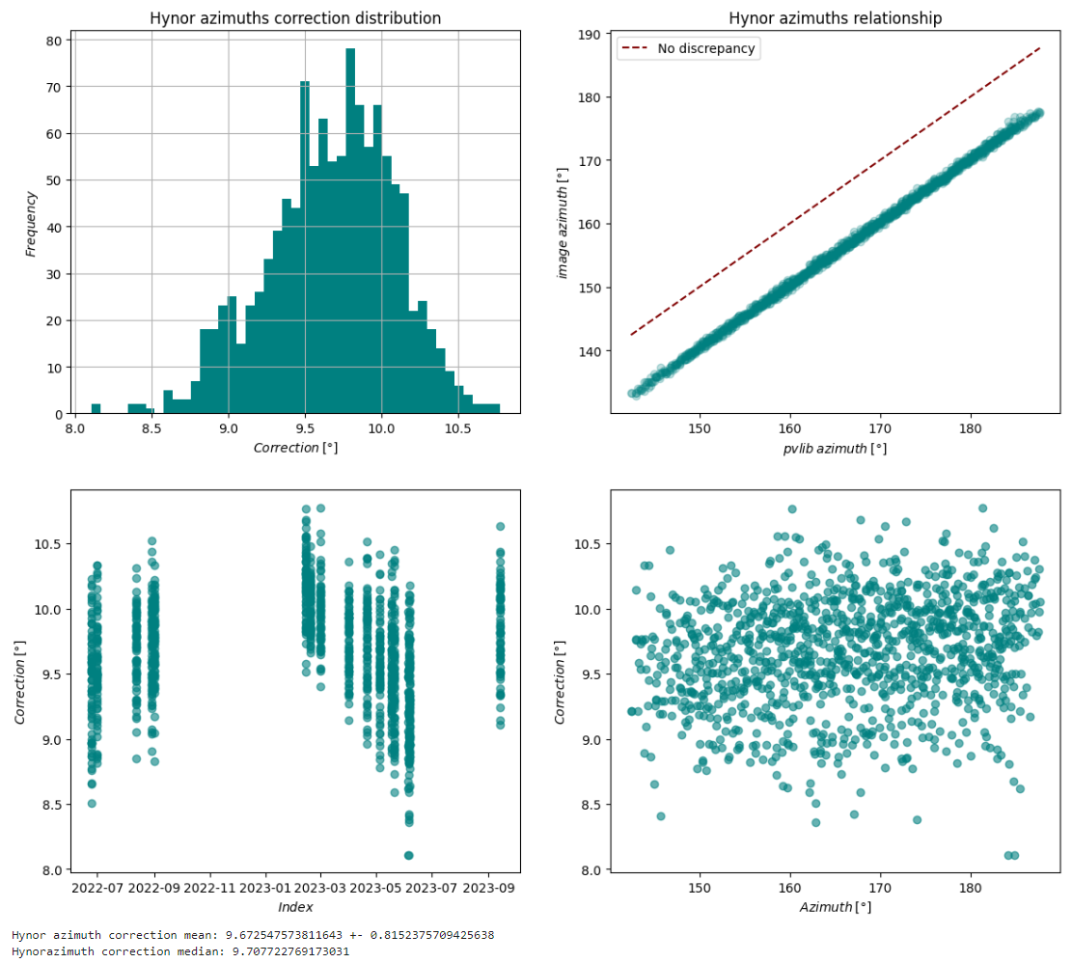
Correcting azimuth
Hynor
  Mean 9.67 +- 0.81
  Median 9.71

Slide 4
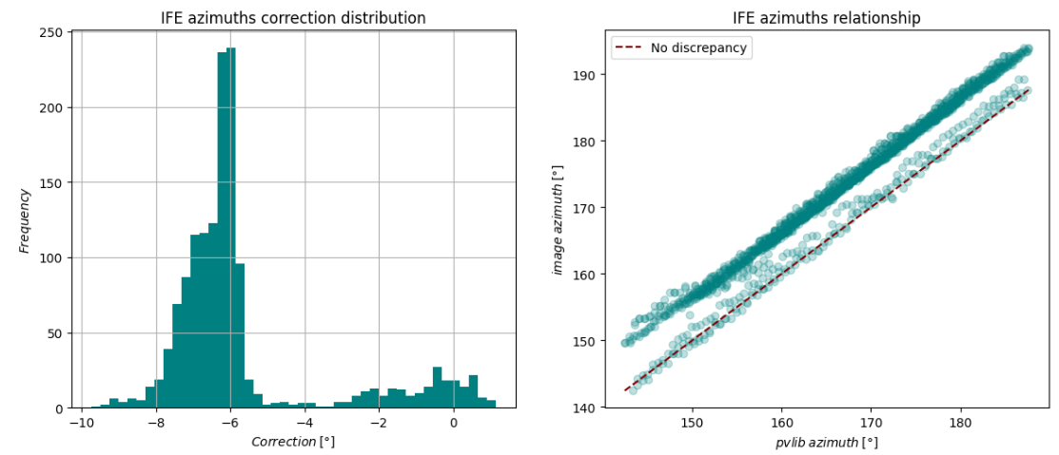
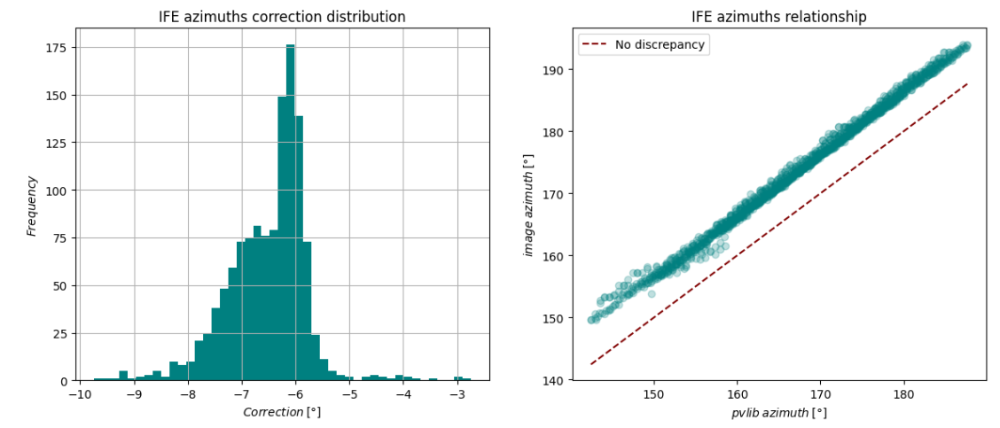
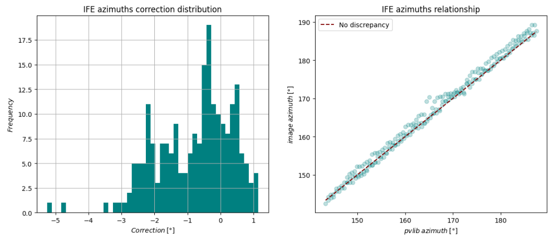
IFE azimuth
After and before 09-2022
  Before -0.8 +- 2.2
  After -6.5 +- 1.46

Slide 5
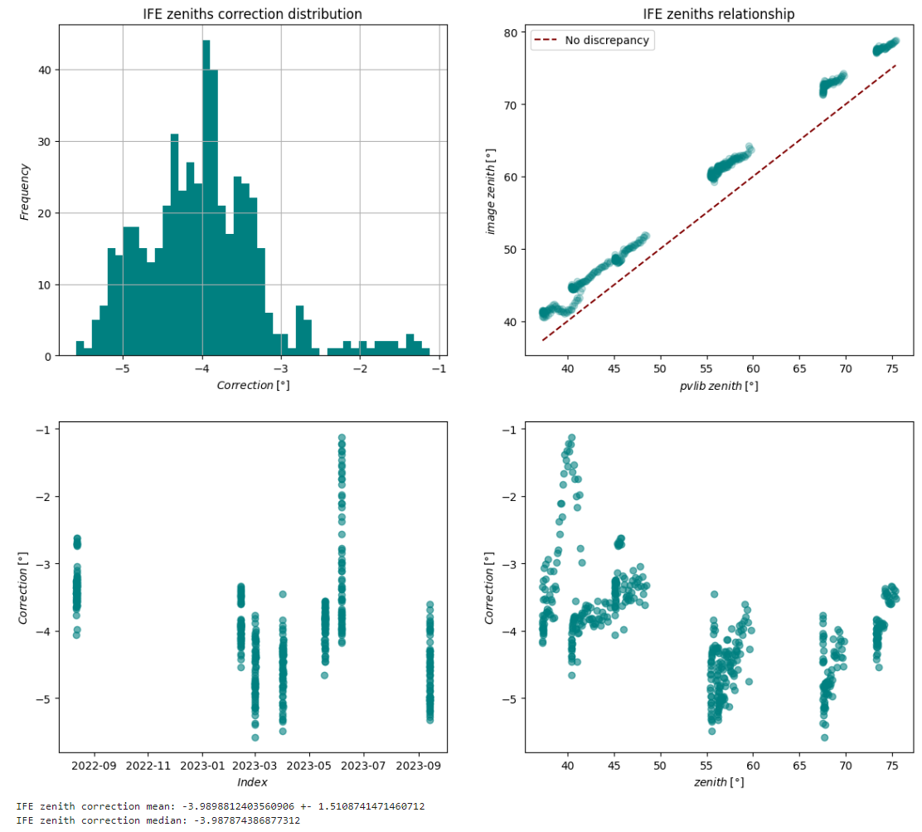
Correcting Zenith
With implementation of only a part of the image being a fisheye image, increasing the proportional radius, making the calculated zenith higher.

Slide 6
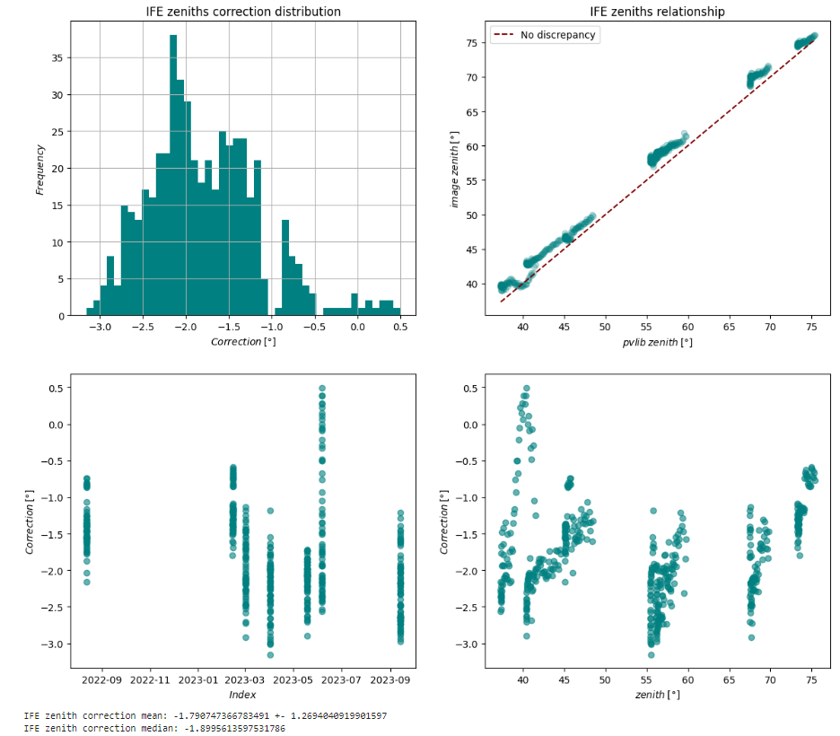
With the whole image 0-90 degrees

Slide 7
Using center of mass algorithm for sun finding

Slide 8
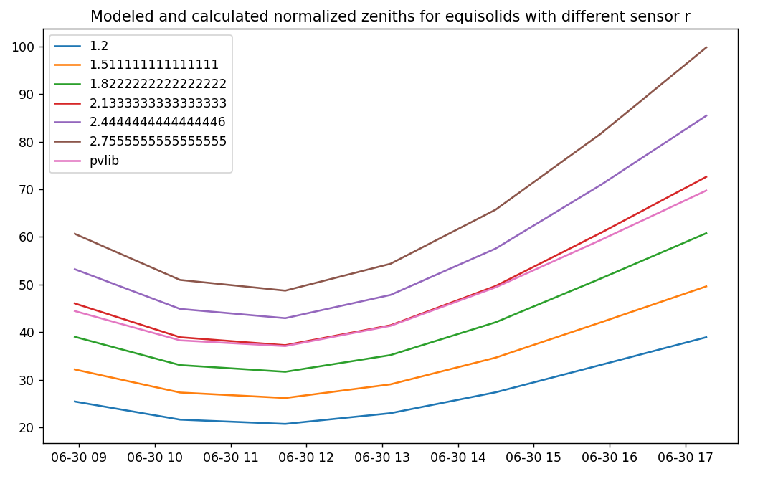
Sensor r variation for equisolid

Slide 9
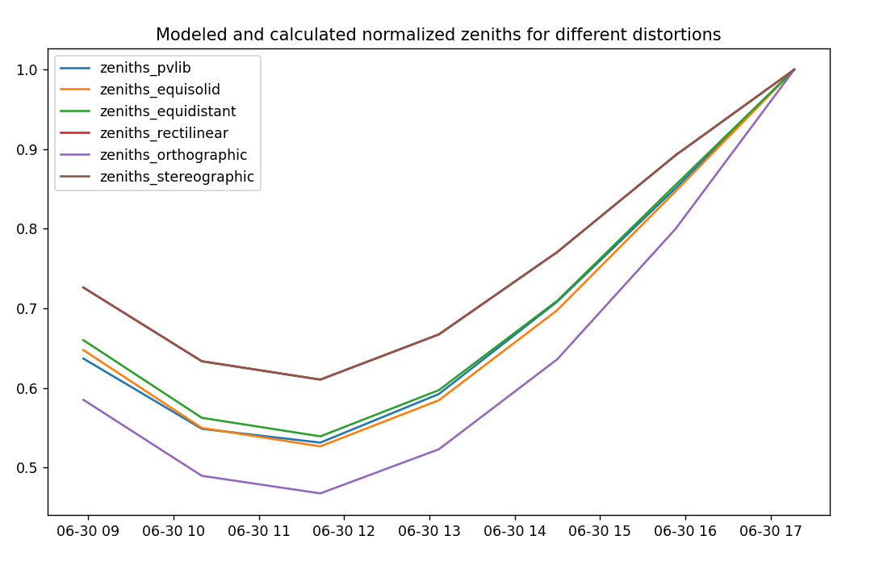
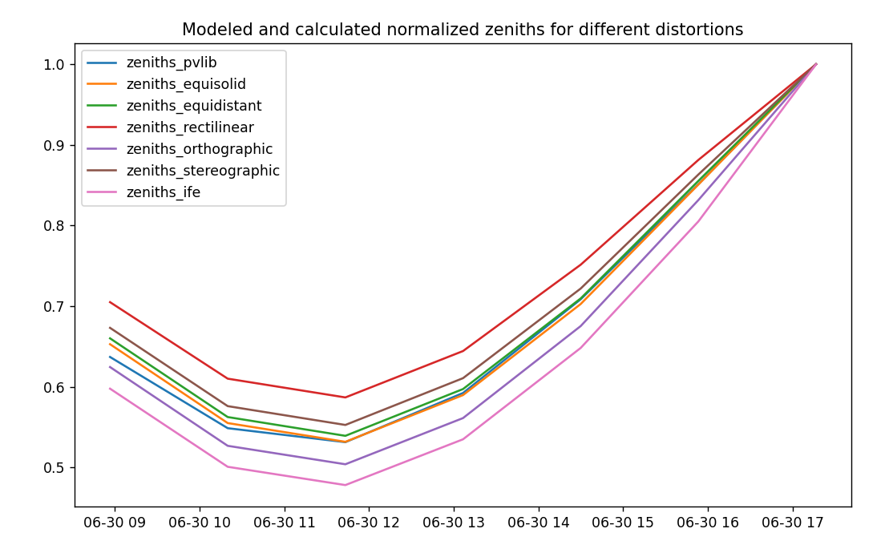
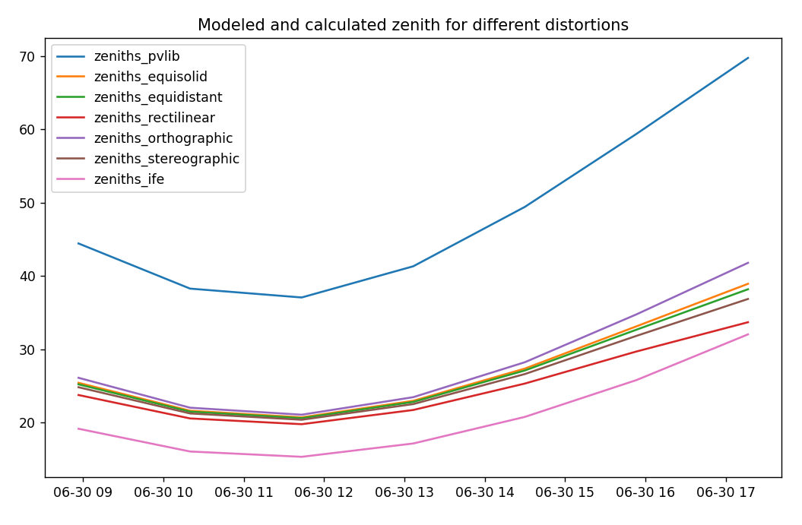
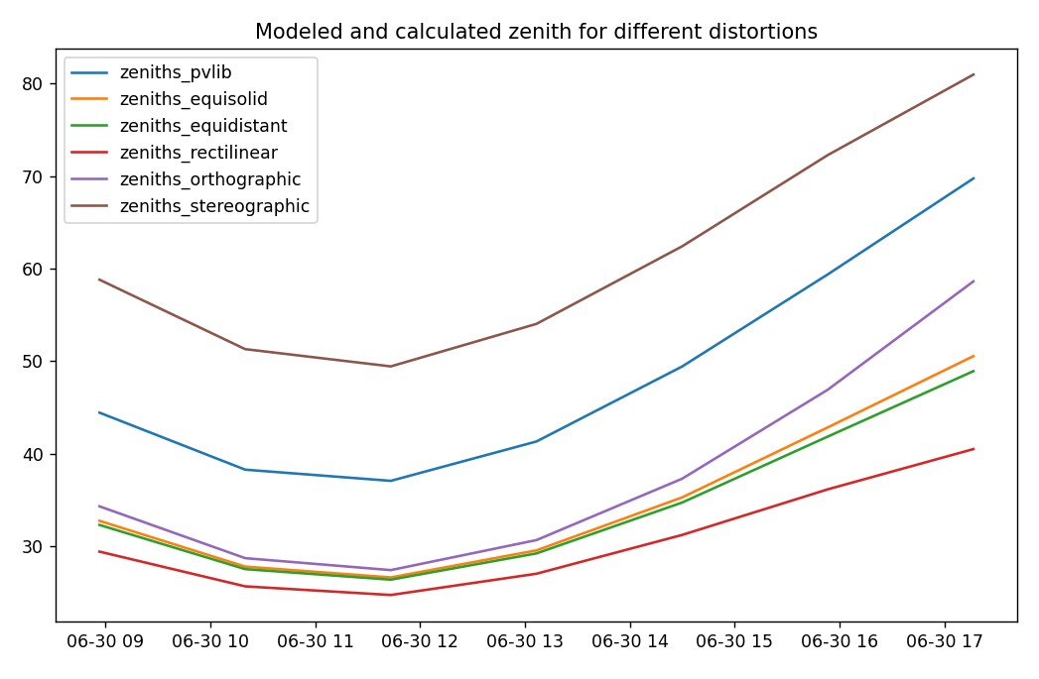
Calc 1 zenith, from rd
Calc 2

